Slide 1
Ridgecrest police department
Budget Presentation
FY18

Slide 2
Overall Goal
Maintain the quality of life and safety of those living and visiting in the city of Ridgecrest

Slide 3
FY18 Staffing
Current staffing
  32 sworn
  19 professional staff
  Total staffing 51
  Plus 118 volunteers
No new positions

Slide 4
Department Functions

Slide 5
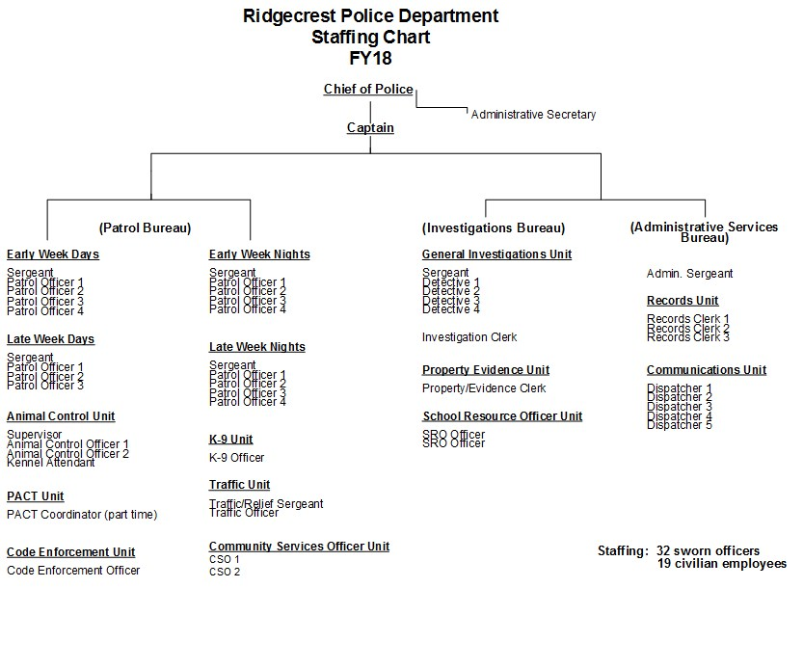

Slide 6
Ridgecrest Crime Trends
Part-one crimes increased 4% in 2016
      2006 – 1160
      2007 – 1042
      2008 – 926
      2009 – 933
      2010 – 988
      2011 – 899
      2012 – 990
      2013 – 998
      2014 – 835 (Lowest Part 1 Crime Rate in the Past Decade)
      2015 - 958
      2016 - 992

Slide 7
Part 1 Crime Trends

Slide 8
Part 1 Crimes
Year | 2008 | 2009 | 2010 | 2011 | 2012 | 2013 | 2014 | 2015 | 2016
Homicide | 1 | 0 | 3 | 1 | 2 | 4 | 0 | 1 | 0
Robbery | 13 | 10 | 12 | 15 | 16 | 26 | 13 | 19 | 21
Rape | 19 | 15 | 12 | 11 | 3 | 9 | 9 | 15 | 24
Assault | 329 | 346 | 334 | 337 | 363 | 385 | 331 | 332 | 372
Total Violent Crimes | 362 | 371 | 361 | 364 | 384 | 424 | 353 | 367 | 417
Burglary | 155 | 170 | 210 | 192 | 236 | 214 | 139 | 160 | 176
Theft | 342 | 335 | 348 | 292 | 326 | 313 | 272 | 372 | 317
Auto Theft | 56 | 42 | 53 | 37 | 41 | 45 | 59 | 51 | 72
Arson | 11 | 15 | 21 | 14 | 3 | 10 | 5 | 8 | 10
Total Property Crimes | 564 | 562 | 632 | 535 | 606 | 582 | 475 | 591 | 575
Total Part One Crimes | 926 | 933 | 993 | 899 | 990 | 997 | 828 | 958 | 992
Percentage | -11% | 1% | 6% | -9% | 10% | 1% | -17% | 16% | 4%

Slide 9
Ridgecrest Crime Trends
20% increase in Part 1 crimes since the passage of Proposition 47
In 2016, Property Crimes decrease 3%
      10% increase in burglaries (total 176)
      41% increase in auto thefts (total 72)
      15% decrease in thefts (total 317)
In 2016, Violent Crime increased 11%
      11% increase in robberies (total 21)
      16% increase in simple assaults (total 268)
      3% increase in aggravated assaults (total 104)
Calls for Service – an average 56 calls per day
      20634 calls for service (12% increase since 2014)
      12626 officer initiated incidents
Arrests
      2542 total arrests
      439 drugs related arrests

Slide 10
Traffic Trends
Injury traffic collisions increased 44% in 2016
      2008 – 83
      2009 – 49
      2010 – 51
      2011 - 66
      2012 – 76
      2013 - 38
      2014 - 35
      2015 - 57 (including 3 fatalities)
      2016 - 82

Slide 11
Public Safety Challenges
Our continued efforts to adapt to the effects of AB 109 (2011), Proposition 47 (2014), and Proposition 57 (2016) on crime in our community
Reduced KCSO presence in IWV
Continued Criminal Justice Reform – AB42 (Bail: Pretrail Release Reform)

Slide 12
Strategy to Address Crime
Maintain current staffing
Continue directed enforcement of known criminals
Address juvenile crime (Teen Court, At-risk youth efforts & SRO involvement at schools)
Focus efforts on solving serious/violent crimes
Look for ways to become more efficient and effective, including technology
Continue to coordinate with other agencies and share resources
Continue our involvement and outreach with the community (volunteer organizations)

Slide 13
Teen Court Statistics
2016
In collaboration with Victory Baptist Church and the City of Ridgecrest
  56 cases (30 completed and 26 failed)
      54% completion rate
  Since 2009, arrests of juveniles have decreased 134% (494 to 211)

Slide 14
Community Involvement
Actively involved in several community groups and programs
  Ridgecrest Police Department Facebook Page ~ over 8200 follow our Facebook page
  The Ridgecrest City Council’s ACTION (Activate Community Talents for Optimal Neighborhoods) Committee
  Youth Advisory Committee
  The Indian Wells Valley Collaborative Group
  Neighborhood Watch
  Teen Court
  School Resource Officer Program
  The Ridgecrest Police Department Explorer Program
  The Ridgecrest Police Department Chaplain Program
  Area Investigators Group
  Annual Police Department Open House
  Women’s Center (officer on the board)
  Coffee with a Cop (in Churches)
  Community Meetings
  Citizens’ Academy (Next academy Fall 2017)

Slide 15
Community Involvement
Continue to rely upon volunteers to provide needed assistance in the organization
  PACT (Police and Citizen’s Together)
    92 volunteers (60 PACT, 27 Animal Welfare & 5 Police Chaplains)
    Volunteered 12975 hours in 2016
    Assists the Police Department in graffiti removal, administrative help, neighborhood watch, vacation house checks, nuisance abatement, animal welfare, vehicle maintenance, animal welfare , Teen Court etc.
  CERT (Community Emergency Response Team)
    17 deployable volunteers
    Volunteered 2832 hours in 2016
    Assists the Police Department in traffic control, EOC preparation, crime scene search, etc.
  Reserve Program TOTAL HOURS: 18,651
    9 volunteers
    Volunteered 2844 hours in 2016 Over $491,267 in value to the City
    ($26.34 per hour)

Slide 16
FY18 Budget
Primarily a status quo budget
  Increases in PERS and Workman’s comp
Overall PD budget is $7,207,281
  Salaries $6,161,816 – 85%
  Materials, Services and Supplies $652,965 – 9%
  Capital $287,500 – 4%
  ISF Fleet - $105,000 – 1%

Slide 17
FY18 Budget
Police Department’s Measure V funding for FY17 - $2,171,264
Measure V funds:
  16 police officers
  2 record clerks
  1 police dispatcher
  1 code enforcement officer
  60k assist in the cost to refurbish 4 patrol vehicles
  12.5k patrol vehicle radios
  5.5k police services (employee background costs)

Slide 18
FY18 Budget
Capital Purchases/Projects
  Refurbish four patrol vehicles 30k each. Savings of 20k per vehicle versus new purchase (Prop 172/Measure V)
  Used training car – 16k (Prop 172)
  Upfit second K9 car from current fleet – 8k (Prop 172)
  Second K-9 – 12k (Prop 172)
  Second Phase City Hall/Police Dept. Security Fencing Project – Carports 110k (Impact Fees)
    Phase 1 will be put out to bid and will be awarded in FY18. Funds from FY 17 (112k Impact fees) will be reobigated after bid award in FY18.

Slide 19
Fee Changes
Increase in Police Report Reproduction Charge $15 to $20
Established a mail reimbursement fee of $3
Established a DVD/USB set up fee of $20
Increased and defined Failure to Pay Admin Citation Fine
  10% after 20 days and 20% each month thereafter. Total delinquent fine is 150% of base fine.

