Slide 1
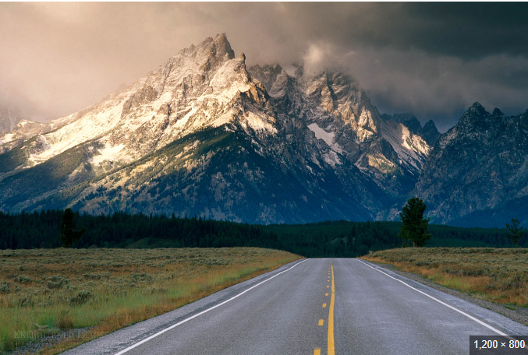
FY 22-23 Measure V Paving Projects

Slide 2
The Projects
FY22 Measure V Paving
  13,080 Tons of Asphalt
  786,000 SF of Paving
  69 Curb Return Ramps (ADA Compliant)
  Total Projected Cost
    $5,234,116
FY 22 Measure V Chip Seal
  1,647,000 SF of Asphalt Resurfaced
  10,000 LF of Cracks filled prior to resurfacing
  Total Project Cost
    $1,237,698

Slide 3
The Projects (Continued)
Franklin Ave. Improvement
  2,690 Tons of Asphalt
  3,600 Cubic Yards of Material Removed/installed
  6,200 SF of Cross Gutter installation
  2,400 LF of Curb and Gutter installation
  Installation of 28 ADA compliant curb return Ramps
  Total Project Cost
    $1,679,300
    $840,500 from Sub-Standard Streets
    $838,800 from Measure V
W. Ward Ave. Phase 1 Street Improvement
  2,120 Tons of Asphalt
  175,000 SF of Road Resurfaced
  2500 SF of Cross Gutter Reconstruction
  Installation of 8 ADA compliant Curb Ramps
  440 LF of Curb and Gutter Replaced
  850 SF of Sidewalk Replaced
  Total Project Cost
    $1,393,000
      $774,611 is Grant (RSTP Funded)
      $618,389 from Measure V

Slide 4
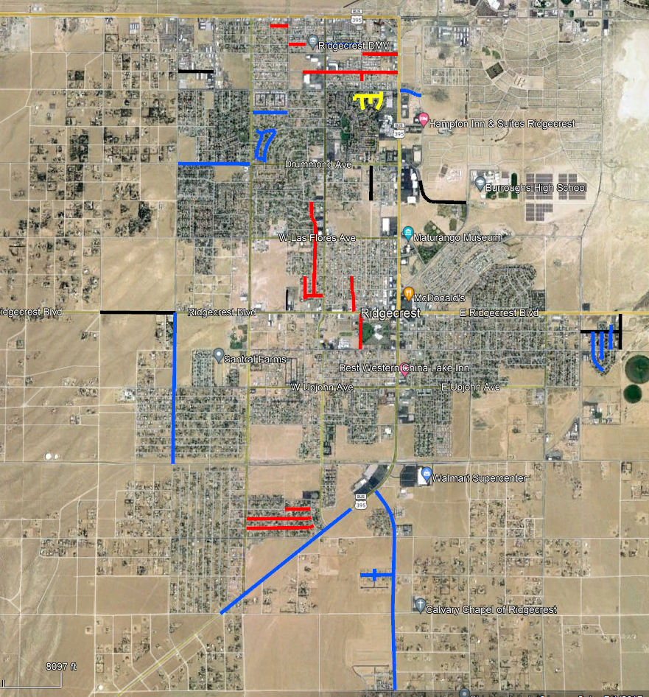
Project Map – FY22 Measure V Projects
Legend
Red – Mill and Fill Paving
    FY22 Measure V Paving Project
Blue– Chip Seal
    FY22 Measure V Chip Seal Project.
Yellow – Mill and Fill Paving
    FY22 Measure V Paving Project

Slide 5
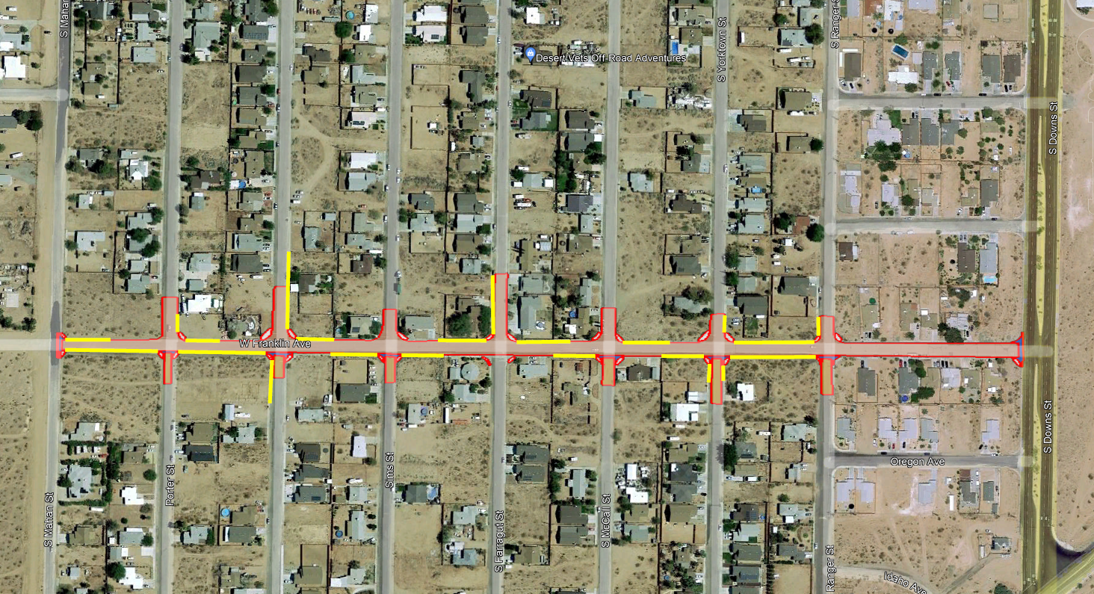
Franklin Ave. Improvement Project
Legend
  Light Tan – Paving
  Yellow – Curb and Gutter
  Red – Limits
  Red w/ Blue Fill– Cross Gutter Spandrel Reconstruct
  Red w/ Grey Fill – Curb Ramp Reconstruct to ADA Compliance.

Slide 6
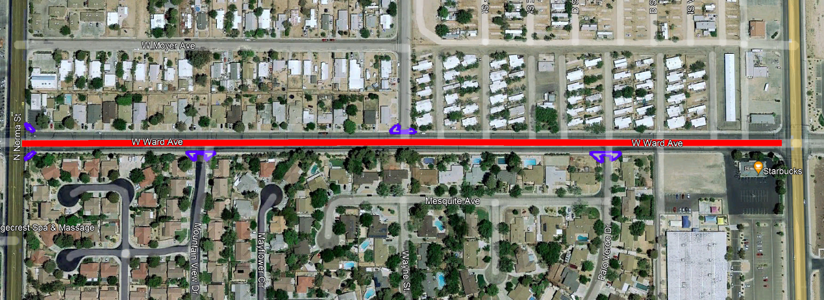
Ward Ave. Improvement Project (50% Measure V Funded)
Ward Ave. Paving
  50% Measure V
  50% RSTP Grant Funding
    Has a Sewer portion Prior to paving.
    Running from China Lake Blvd to Downs St. to prep for Phase 1 and Phase 2 of Ward
  Legend
    Red – Paving
    Blue w/ Grey fill – Curb Ramp, Cross Gutter & Spandrel Reconstruction.

Slide 7
Street Improvement List
FY22 Measure V Paving
FY22 Measure V Chip Seal
Franklin Ave & Ward St. Improvements
Atkins – Gordon St. to Sierra View
Includes C&G and Sidewalk Install
Perdew – Sierra View East to Cul- de-sac end.
Graff – Wayne St. to China Lake Blvd.
Reeves – N. Albertsons W. PL to China Lake Blvd.
Includes C&G and Sidewalk
Mesquite, Palo Verde and Wayne (S. of Ward St.) All areas.
Alvord – Argus St. to Ridgecrest Blvd
Peg – Felspar Ave. to Vera Ave.
Vera – Norma St. to Sierra Vista St.
Sierra Vista – Argus to end of Cul-de-sac.
Warner – Ridgecrest Blvd. to Church Ave.
Wildrose – Sierra View St. to Allen St.
Coral – Downs St. to Allen St.
Wasp – Downs St. to Allen St.
Perdew – Norma St. to Wayne St.
E. Ward – China Lake Blvd to Chelsea St.
Kinnett – Sierra View St. to Downs St.
Sydnor – Randall St. to Scott St.
Randall- Hurschell Ave. to Cul-de-sac end.
Hurschell – Scott St. to Randall St.
Scott – Drummond Ave. to Sydnor Ave.
Drummond- Mahan St. to Downs St. (excludes new asphalt & E. bound Drummond from Inyo St. to Mahan St.
Mahan St. – Bowman Rd. to Ridgecrest Blvd.
S. China Lake Blvd – Springer Ave. to S. boundary of old Walmart.
College Heights – Kendall Ave. to China Lake Blvd.
Franklin- College Heights Blvd. to end
Calle De Casa- N. End to new asphalt
Larkspur – California Ave. to Locust St.
Lilac – California Ave. to end.
Locust- Church Ave. to North end of Cul-de-sac.
Franklin Ave
From Mahan St. to Downs St.
Full Reconstruction
Ward Ave Phase 1 (2022/2023 Const.)
From China Lake Blvd.
to Norma St.
Ward Ave Phase 2 (2023/2024 Const.)
From Norma St.
to Downs St.
* Phase 2 Includes Re-profiling of Norma St. and Sierra View to remove bumps and dips.

Slide 8
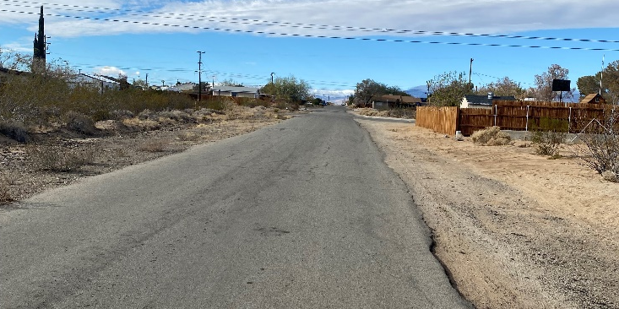
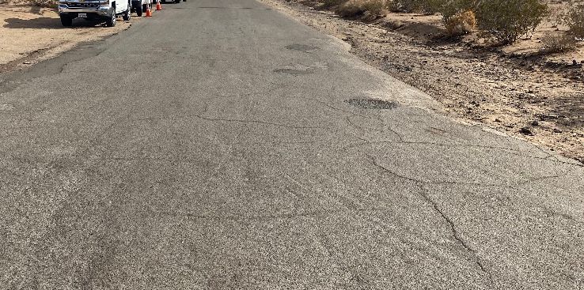
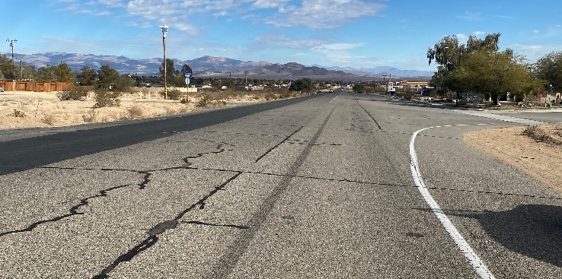
Caution – Road Work Ahead!
Franklin Ave.
Franklin Ave.
China Lake Blvd.
Franklin Ave. Improvement Project
Franklin Ave. Improvement Project
FY22 Measure V Chip Seal

Slide 9
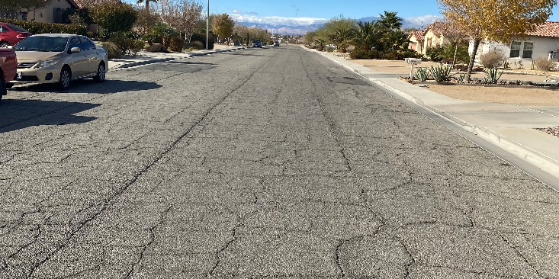
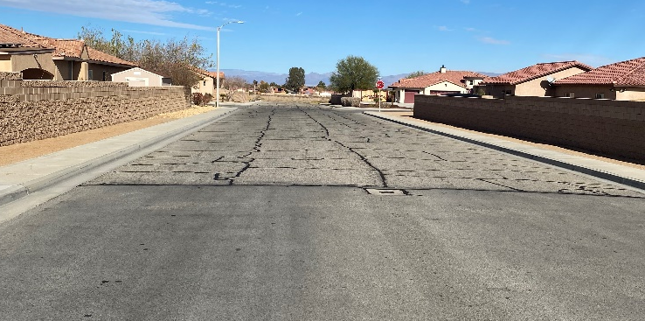
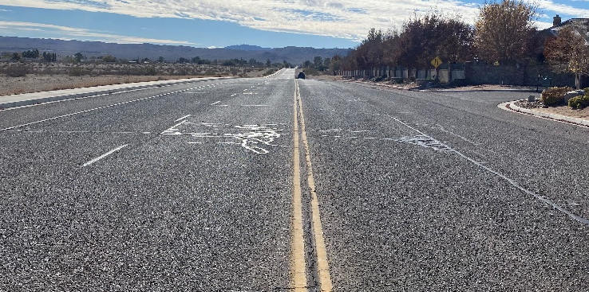
Caution – Road Work Ahead!
Franklin Ave.
Calle De Casa St.
Mahan St.
FY22 Measure V Chip Seal
(Near College Heights Blvd.)
FY22 Measure V Chip Seal
FY22 Measure V Chip Seal

Slide 10
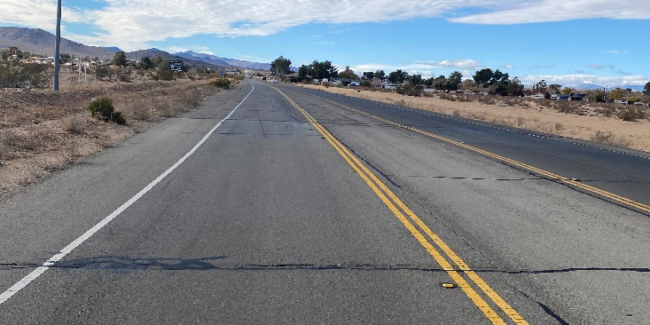
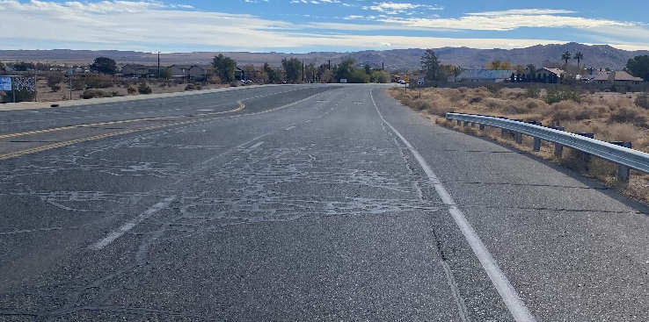
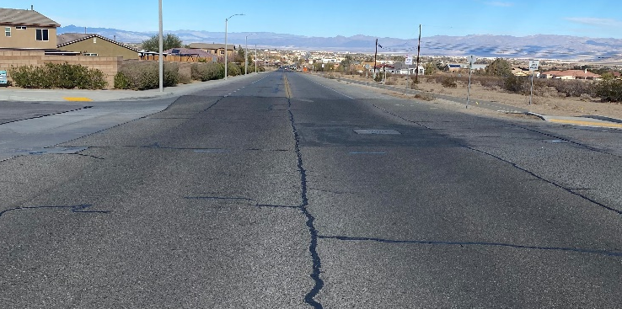
Caution – Road Work Ahead!
China Lake Blvd.
College Heights Blvd.
College Heights Blvd.
FY22 Measure V Chip Seal
FY22 Measure V Chip Seal
FY22 Measure V Chip Seal

Slide 11
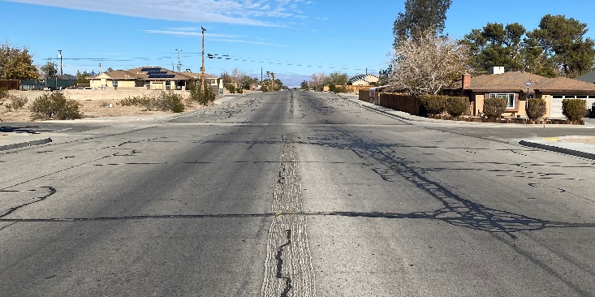
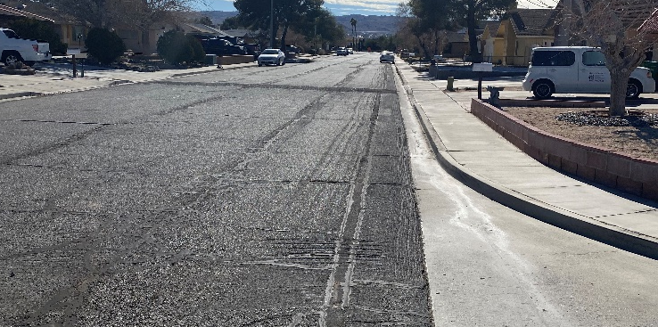
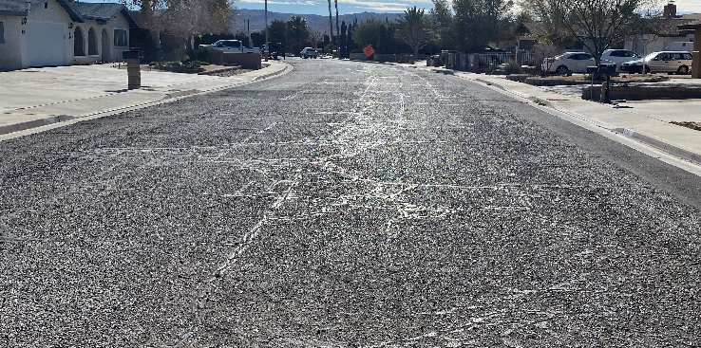
Caution – Road Work Ahead!
Mahan St.
Larkspur St.
Larkspur St.
FY22 Measure V Chip Seal
FY22 Measure V Chip Seal
FY22 Measure V Chip Seal

Slide 12
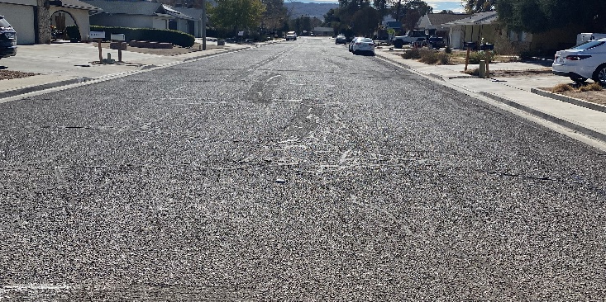
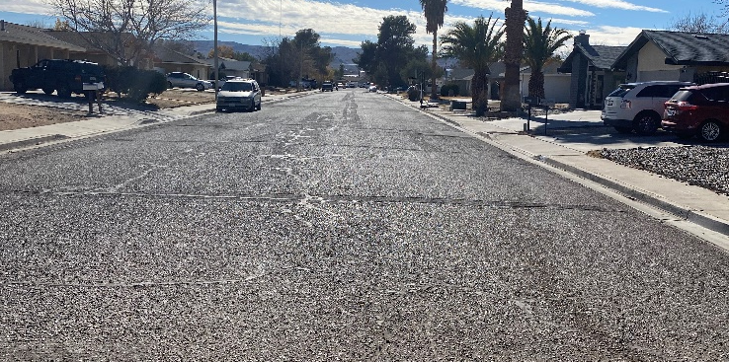
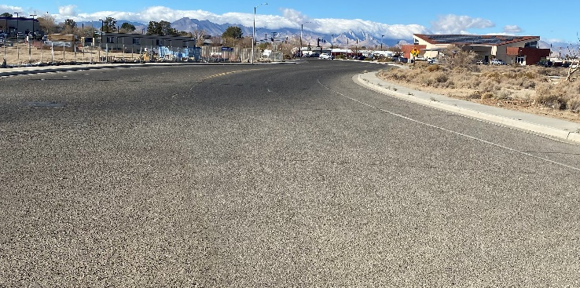
Caution – Road Work Ahead!
Lilac St.
Locust St.
E. Ward Ave.
FY22 Measure V Chip Seal
FY22 Measure V Chip Seal
FY22 Measure V Chip Seal

Slide 13
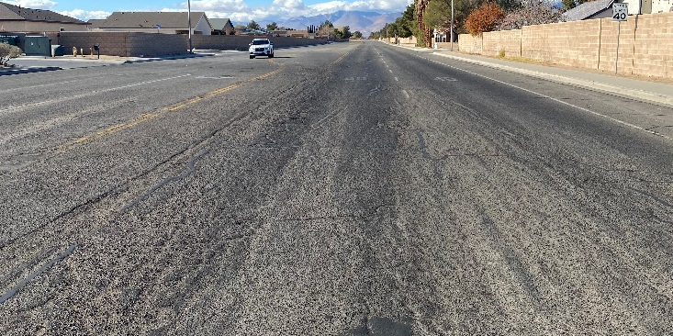
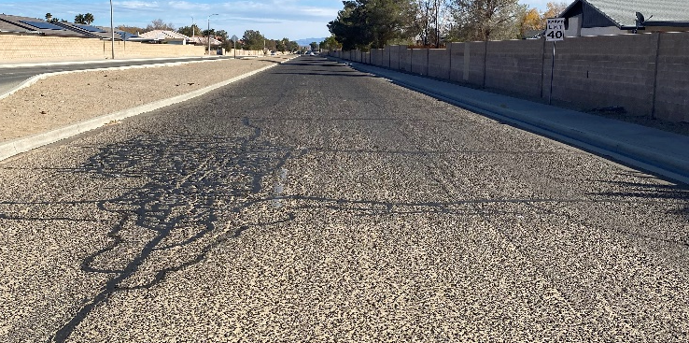
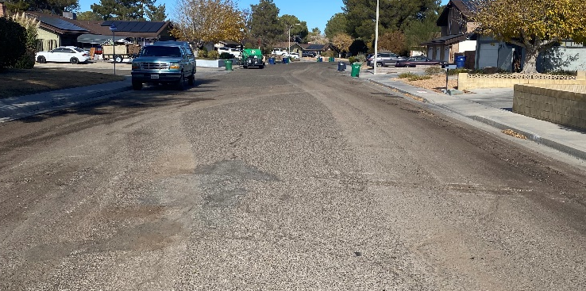
Caution – Road Work Ahead!
W. Drummond Ave.
W. Drummond Ave.
Scott St.
FY22 Measure V Chip Seal
FY22 Measure V Chip Seal
FY22 Measure V Chip Seal

Slide 14
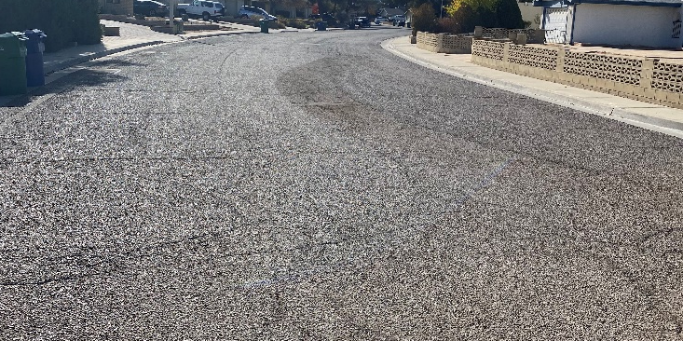
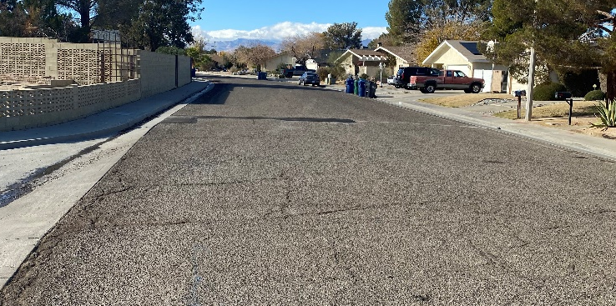
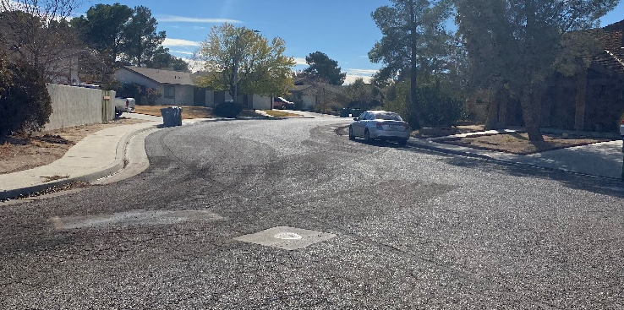
Caution – Road Work Ahead!
Scott St.
Sydnor Ave.
Randall St.
FY22 Measure V Chip Seal
FY22 Measure V Chip Seal
FY22 Measure V Chip Seal

Slide 15
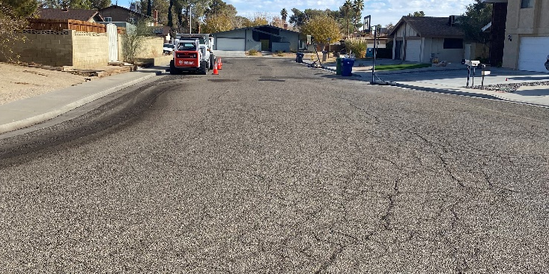
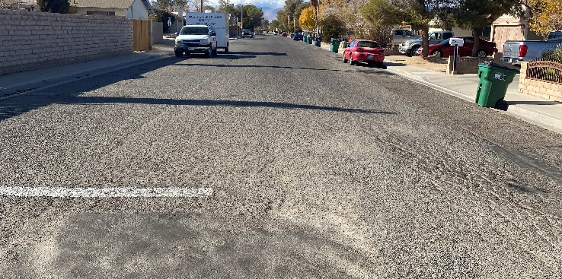
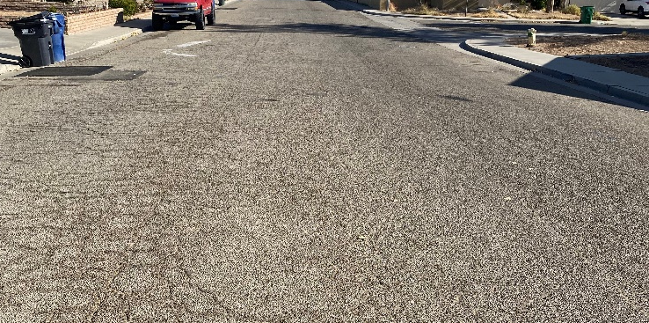
Caution – Road Work Ahead!
Hurschell Ave.
Kinnett St.
Kinnett St.
FY22 Measure V Chip Seal
FY22 Measure V Chip Seal
FY22 Measure V Chip Seal

Slide 16
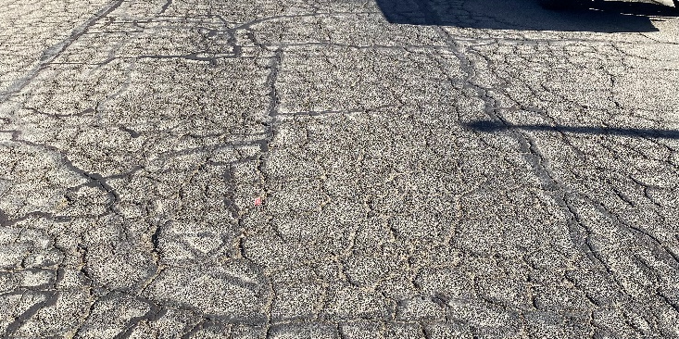
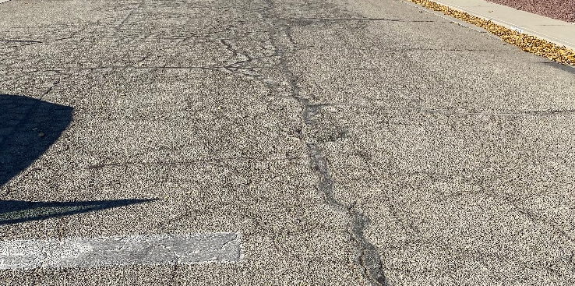
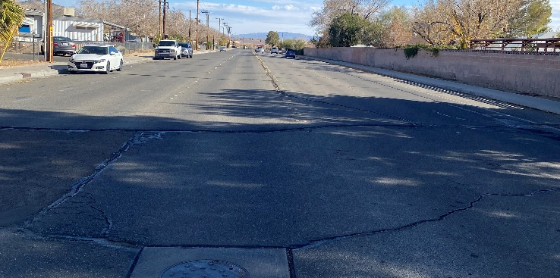
Caution – Road Work Ahead!
Perdew Ave.
Perdew Ave.
W. Ward Ave.
FY22 Measure V Chip Seal
(Wayne St. to Norma St.)
FY22 Measure V Chip Seal
(Wayne St. to Norma St.)
Ward Ave. Improvement Project
(50% RSTP Grant; 50% Measure V)

Slide 17
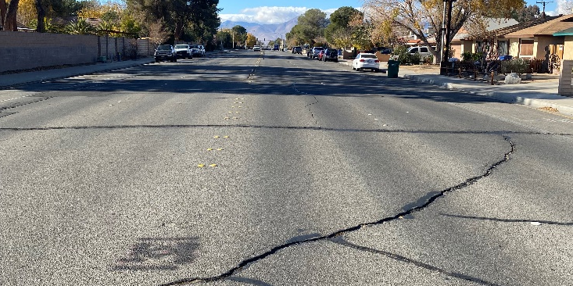
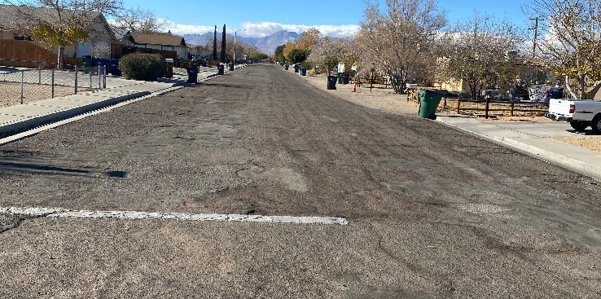
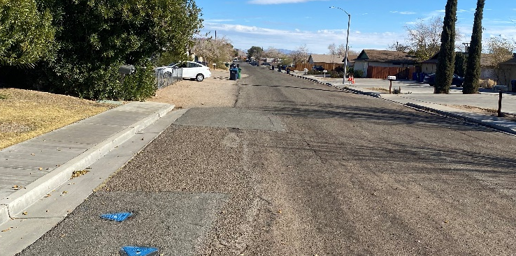
Caution – Road Work Ahead!
W. Ward Ave.
Atkins St.
Atkins St.
Ward Ave. Improvement Project
(50% RSTP Grant; 50% Measure V)
FY22 Measure V Paving
(Includes Sidewalk, Curb and Gutter)
FY22 Measure V Paving
(Includes Sidewalk, Curb and Gutter)

Slide 18
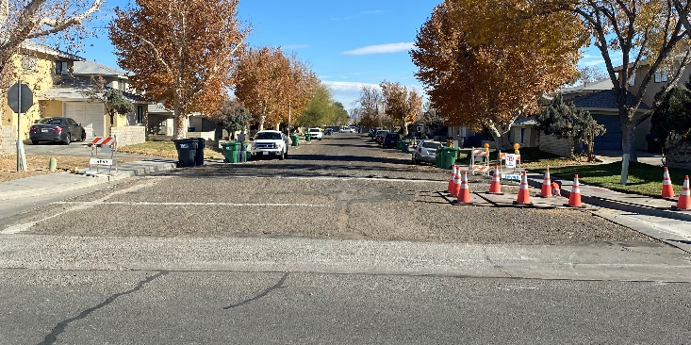
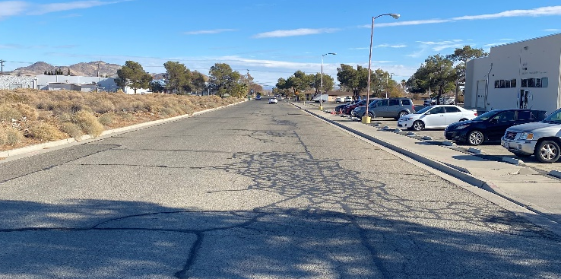
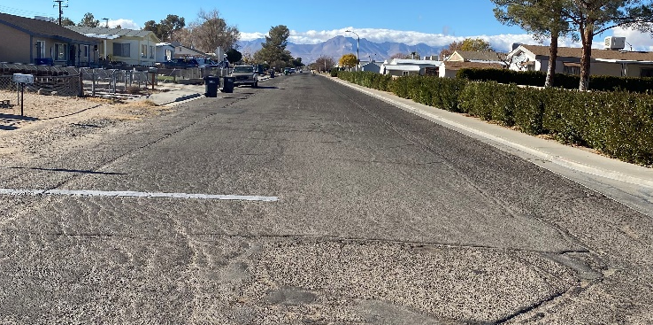
Caution – Road Work Ahead!
Perdew Ave.
Reeves St.
Reeves St.
FY22 Measure V Paving
(Sierra View St. to end of Cul-de-sac)
FY22 Measure V Paving
(West PL North Albertsons to China Lake Blvd.)
FY22 Measure V Paving
(Includes Sidewalk, Curb and Gutter connecting segments)

Slide 19
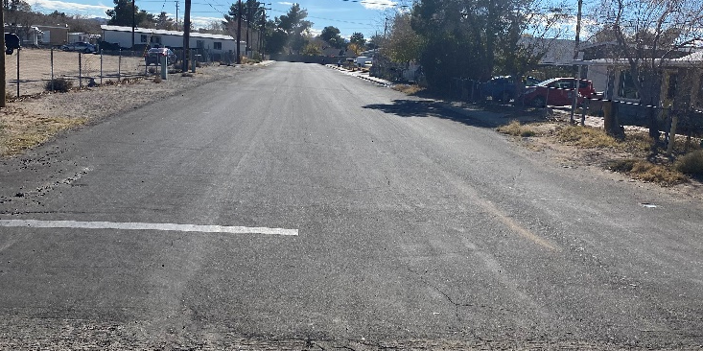
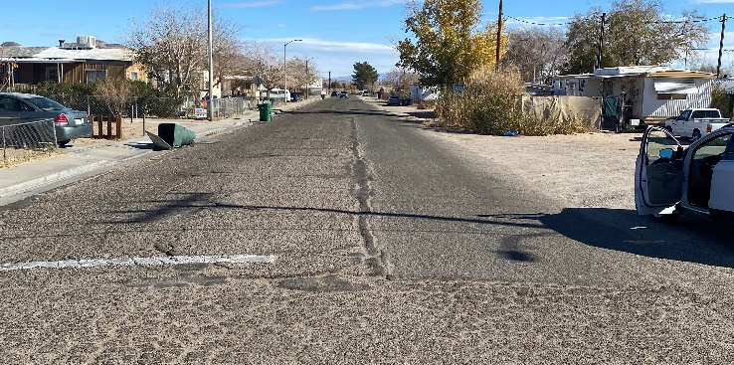
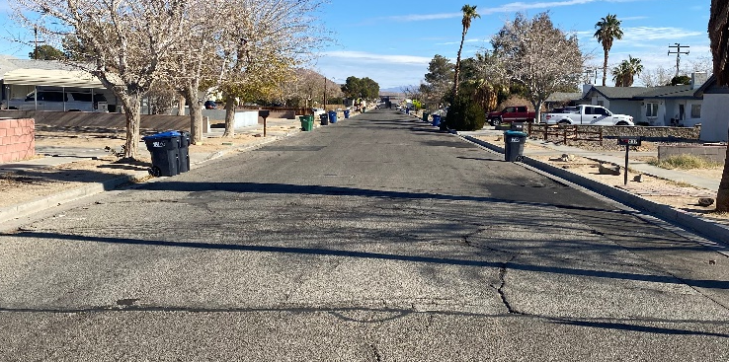
Caution – Road Work Ahead!
Wayne St.
Reeves St.
Graff Ave.
FY22 Measure V Paving
(North of Reeves Ave.
Includes Sidewalk, Curb and Gutter)
FY22 Measure V Paving
(Includes Sidewalk, Curb and Gutter)
FY22 Measure V Paving

Slide 20
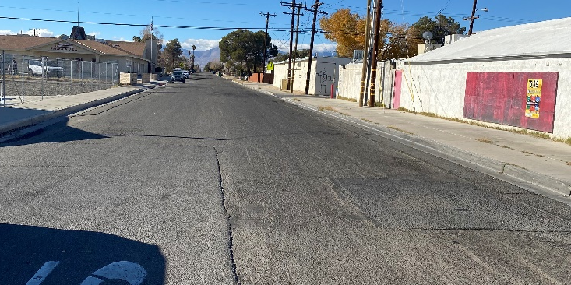
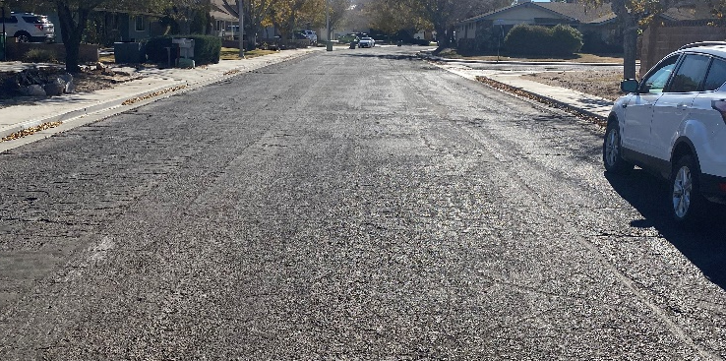
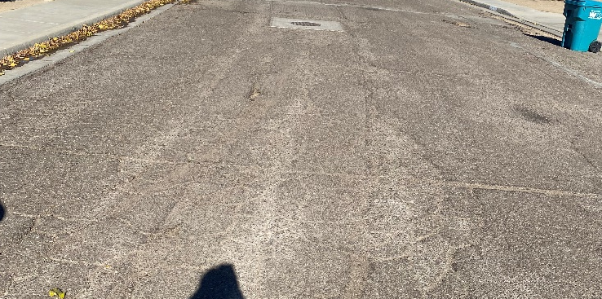
Caution – Road Work Ahead!
Graff Ave.
Palo Verde St.
Palo Verde St.
FY22 Measure V Paving
FY22 Measure V Paving
(South of Ward Ave.)
FY22 Measure V Paving
(South of Ward Ave.)

Slide 21
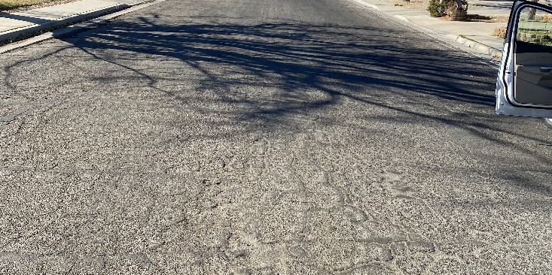
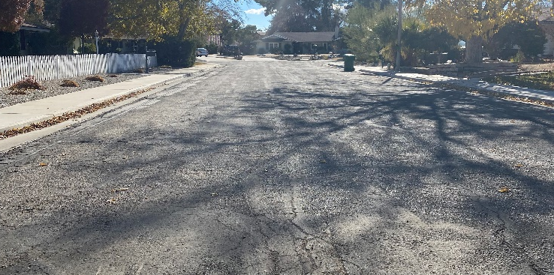
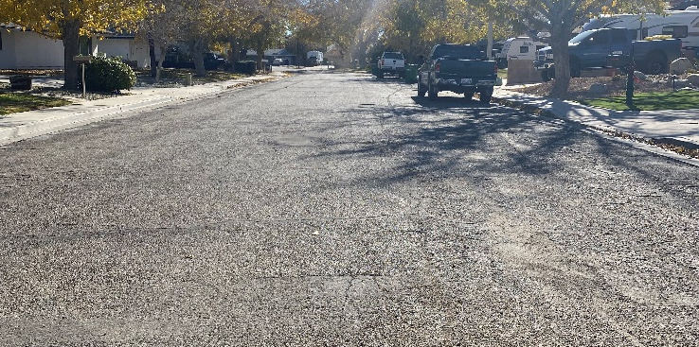
Caution – Road Work Ahead!
Mesquite Ave.
Sage St.
Wayne St.
FY22 Measure V Paving
(Palo Verde St. to end)
FY22 Measure V Paving
(Mesquite Ave. to end)
FY22 Measure V Paving
(Mesquite Ave. to end)

Slide 22
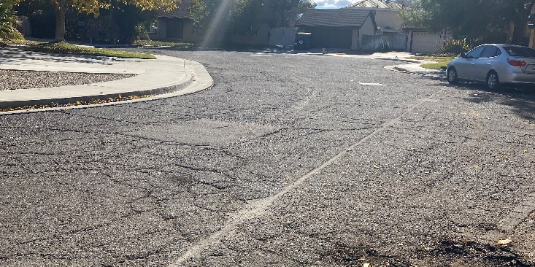
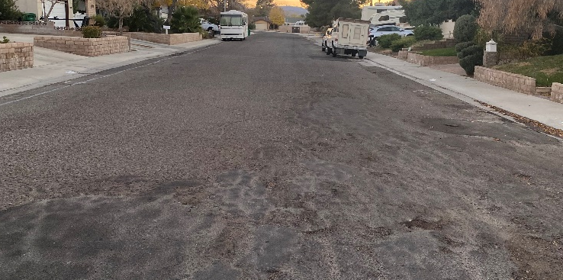
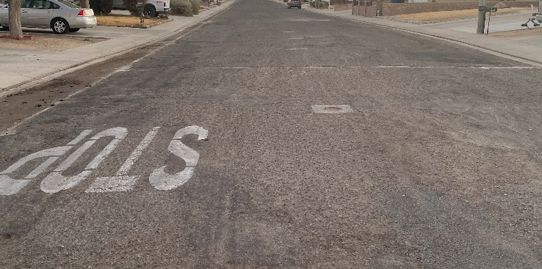
Caution – Road Work Ahead!
Mesquite Ave.
Peg St.
Peg St.
FY22 Measure V Paving
(Palo Verde St. to end)
FY22 Measure V Paving
FY22 Measure V Paving

Slide 23
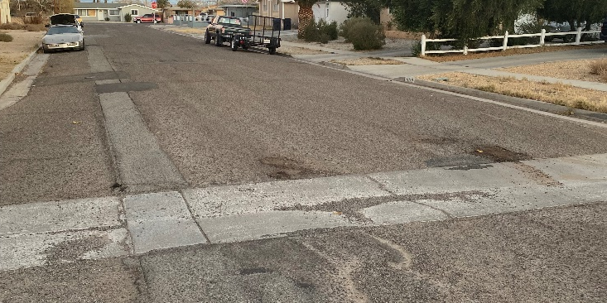


Caution – Road Work Ahead!
Vera Ave.
Vera Ave.
Sierra Vista St.
FY22 Measure V Paving
FY22 Measure V Paving
FY22 Measure V Paving

Slide 24



Caution – Road Work Ahead!
Alvord St.
Alvord St.
Warner St.
FY22 Measure V Paving
FY22 Measure V Paving
FY22 Measure V Paving

Slide 25



Caution – Road Work Ahead!
Warner St.
Wildrose Ave.
Wildrose Ave.
FY22 Measure V Paving
FY22 Measure V Paving
FY22 Measure V Paving

Slide 26



Caution – Road Work Ahead!
Coral Ave.
Coral Ave.
Wasp Ave.
FY22 Measure V Paving
FY22 Measure V Paving
FY22 Measure V Paving

Slide 27
The Balancing Act
Original Budgets
  FY22 Measure V Paving – $3.75 Million
  FY22 Measure V Chip Seal – $1.5 Million
  Franklin Ave. – $0.00
  Ward Ave. – $1 Million
    Total Budget for Street Improvement = $6.25 Million
    Reserve as of FY22 Start – $2.3 Million
Reserve to Date after all projects are complete = +/- $400,000
Public Works will Effectively Spend The Carry Over as Promised!

Slide 28
Why was this all Possible?
Measure V
  Accounts for +/-95% of the Road Maintenance Budget
Thank You Ridgecrest for Trusting City Staff & Council to
“GET THINGS DONE”

