Slide 1
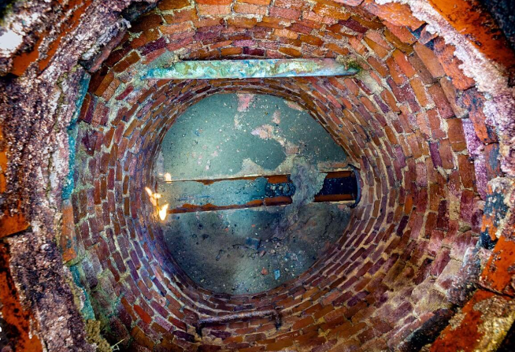
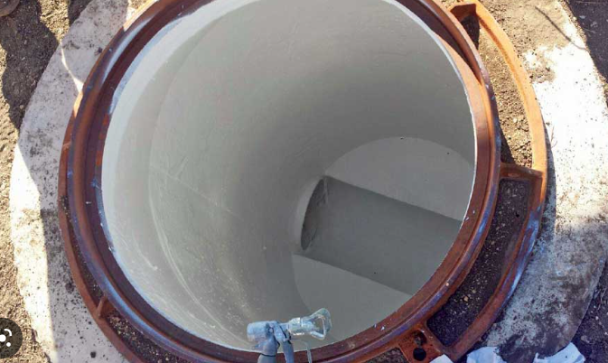
FY 22-23 Wastewater Enterprise Projects

Slide 2
The Projects
Ward Ave. Sewer Line Repair.
Construction from East of N. China Lake Blvd through Downs St.
Sewer project prepares all underground for Phase 2 Paving Project (Norma St. to Downs St.)
430 LF of VCP Replacement with PVC SDR-35
4 Lateral Connections Reconstructed
21 Man Holes Reconstructed
27 Man Holes Epoxy Lined.
Total Projected Cost
$874,436
Phase II Sewer
Construction in California Ave. From Richman Rd. to China Lake Blvd. & in China Lake Blvd from California Ave. to Argus Ave.
Remove and Replace 3600 LF of VCP Sewer
CIPP Line 2200 LF of VCP Sewer
Remove/Replace Repair and Epoxy Line 37 Sewer Man Holes
Perform Post Installation CCTV inspection.
Total Project Cost
$7,394,397

Slide 3
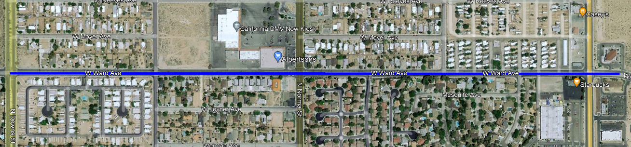
Project Map – Ward Ave Sewer Reconstruction
Legend
Blue – Sewer Repair Replace and/or Line.

Slide 4
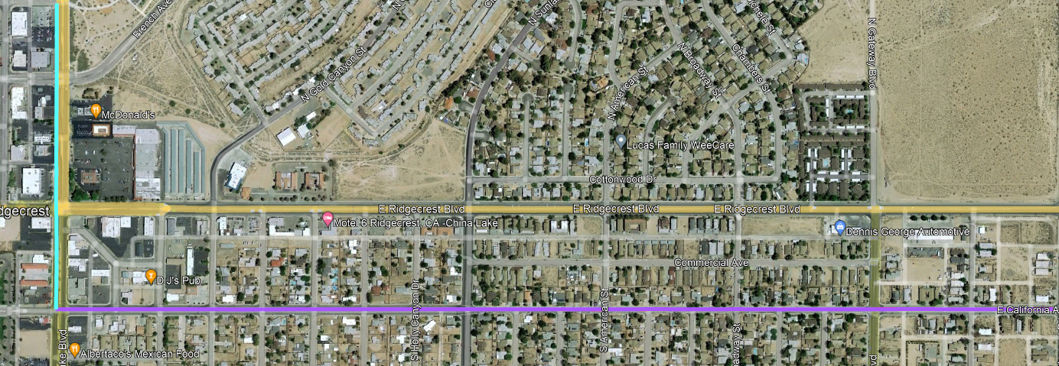
Project Map – Phase II Sewer Reconstruction
Legend
Teal– 15” VCP Replacement
Purple – 18” VCP Repair/Replace/Line

Slide 5
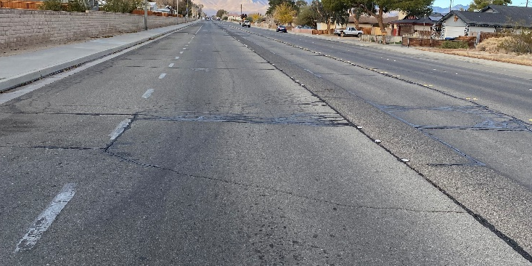
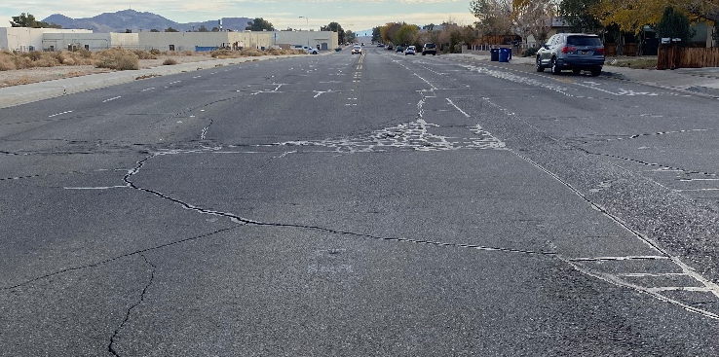
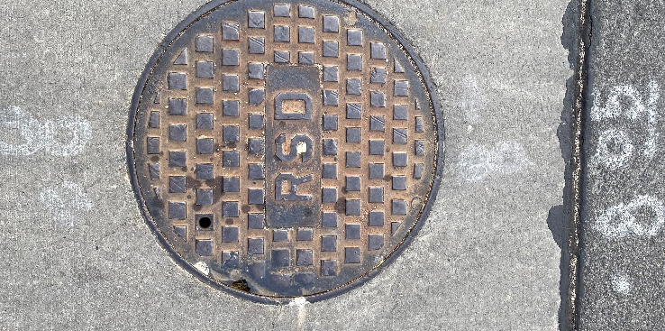
Caution – Underground Work Ahead!
Ward Ave.
Ward Ave.
Ward Ave.
Ward Ave. Improvement Project
Ward Ave. Improvement Project
Ward Ave. Improvement Project

Slide 6
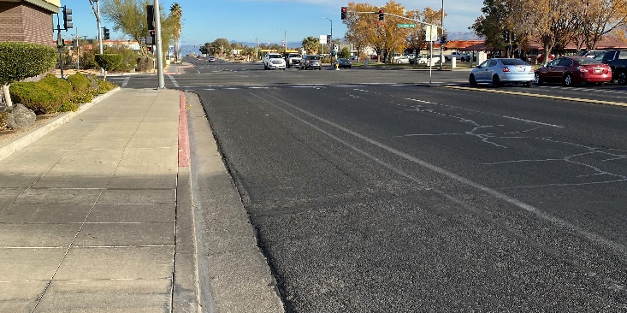
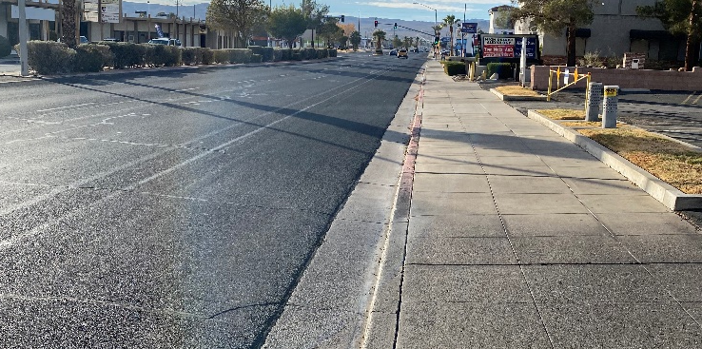
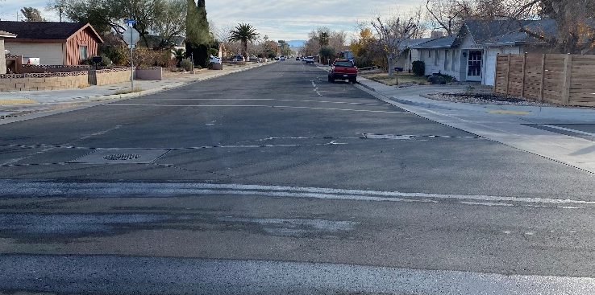
Caution – Underground Work Ahead!
China Lake Blvd
China Lake Blvd
California Ave.
Phase II Sewer
Phase II Sewer
Phase II Sewer

Slide 7
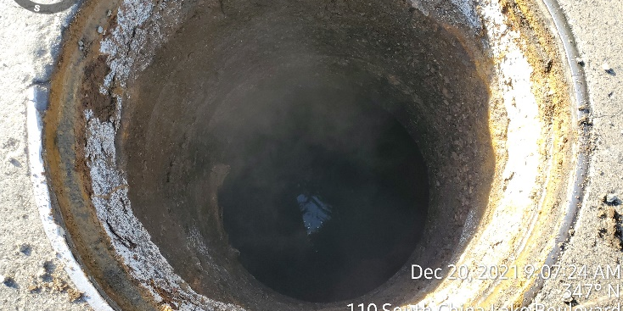
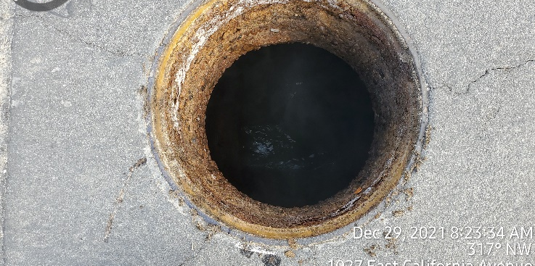
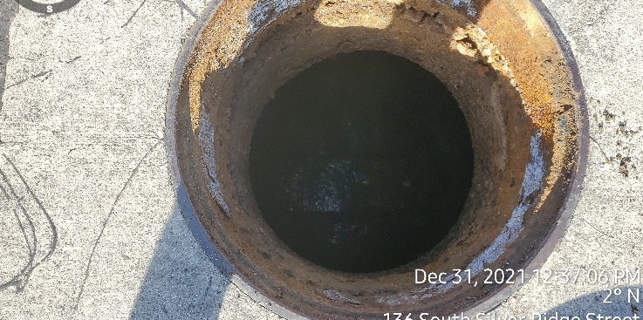
Caution – Underground Work Ahead!
China Lake Blvd
California Ave
California Ave.
Phase II Sewer
Phase II Sewer
Phase II Sewer

Slide 8
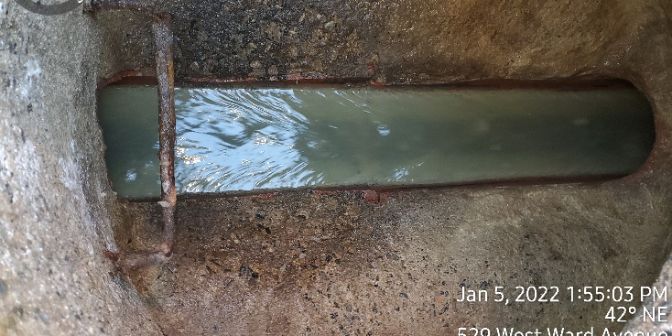
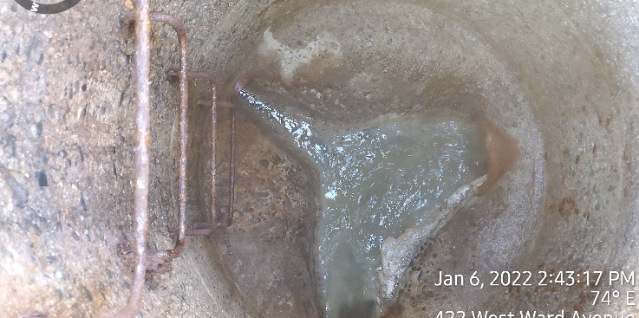
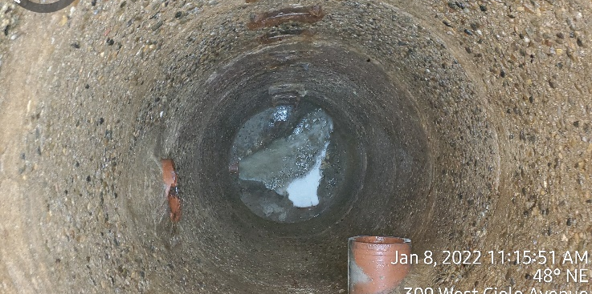
Caution – Underground Work Ahead!
Ward Ave.
Ward Ave.
Ward Ave.
Cast in Place Bottom Deterioration
Deteriorated Man Hole
Protruding laterals.

Slide 9
The Balancing Act
Original Budgets
Ward Ave.– $1.13 Million (Sewer only)
Expected Expenditure - $874,436.00
Phase II Sewer– $2.1 Million
(Based on a 2015 estimate, we were not far enough along with the Project Design to accurately Budget)
Another Large Cost Discrepancy is the Paving Restoration within State Route 178. This alone is over 1 million dollars.
The Reason for spending this money?
This is a Major Trunk Line and handels roughly 65% of the City’s Sewer Flow.
We have designed a Pipeline that will be a 50-75 year life span.
It is expensive to dig in 178…. SO LETS DO IT ONCE.
Reserve to Date after all projects are still healthy.

Slide 10
Why was this all Possible?
Wastewater Enterprise Fund
Accounts for +/-100% of the Wastewater Budget
The increased Sewer Rate has allowed us to not bond any work to date!
Saving your Tax Dollars.
Thank You Ridgecrest for Trusting City Staff & Council to
“GET THINGS DONE”

